Slide 1
DANA 4840
Classification II
Part II Partitional Clustering
Part 4 – Silhouette widths

Slide 2

Silhouette Width
Silhouette width = $\frac{b−a }{max(a,b)}$
Students to draw a diagram with three clusters and illustrate how to calculate silhouette width for any point:

Slide 3
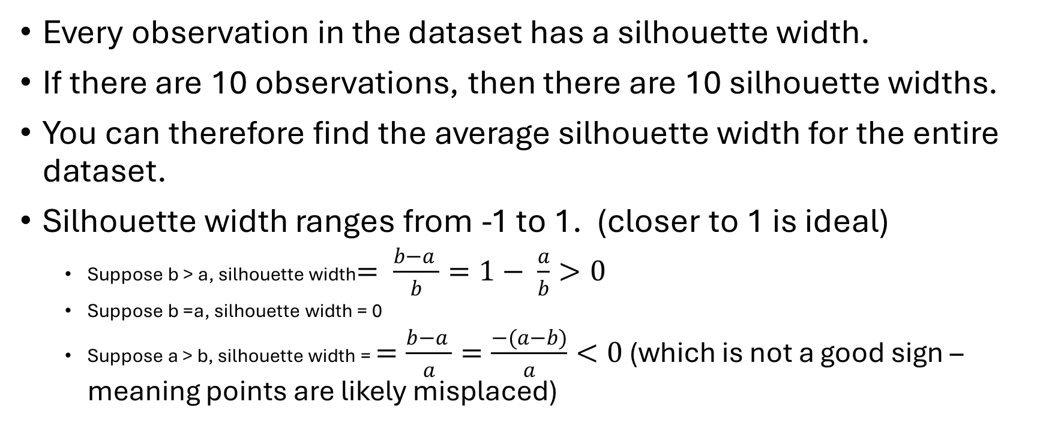
Silhouette widths
Every observation in the dataset has a silhouette width.
If there are 10 observations, then there are 10 silhouette widths.
You can therefore find the average silhouette width for the entire dataset.
Silhouette width ranges from -1 to 1. (closer to 1 is ideal)
Suppose b > a, silhouette width$= \frac{b−a }{b}=1− \frac{a}{b}>0$
Suppose b =a, silhouette width = 0
Suppose a > b, silhouette width = $=\frac{b−a }{a}=\frac{−(a−b)}{a}<0$ (which is not a good sign – meaning points are likely misplaced)

Slide 4
R code:
Learn how to use R to find silhouette widths for every single observation
Learn how to use R to determine k using silhouette approach
Learn how to produce visual plots showing which cluster has negative silhouette widths

